Slide 1
HIS103: Emergence of Bangladesh
1970 Elections in Pakistan: Background, Results and Consequences
April 01, 2022

Slide 2
The Elections of 1970
Yahya in Office:
The announcement of resignation by the Ayub Khan was followed by a proclamation issued by General Yahya Khan in which he declared Martial Law and assumed the powers of the Chief Martial Law Administrator.
He started the office of President on 31st March, 1969. After coming to the power, he abrogated the Constitution of 1962, dissolved both the National and Provincial assemblies, ceased the power of President, the Central and provincial ministers and the Governors offices.
He announced that no courts would have any power to call in question any Martial Law regulation or any judgment of a military court, or to issue any writ or order against the Chief Martial Law Administration or any person acting under his authority. He appointed Major General Muzaffaruddin as the Martial Law administrator in charge of East Pakistan.
However, he did not ban political parties’ activity rather restricted their programs.

Slide 3
The Elections of 1970
Yahya in Office:
In his first address to the nation, Yahya gave the impression that his regime was transitory in character and the aim of his government was to establish a constitutional government and to ensure smooth transfer of power to the representatives of the people elected freely and impartially on the basis of universal adult franchise, i.e., one-man-one-vote.
Yahya promised a “smooth transfer of power to the representatives of the people elected freely and impartially on the basis of adult franchise”, who would then “give the country a workable Constitution”. He also promised to arrange a free and fair election by 1970.
The mass movement in both East and West Pakistan came to a sudden halt. There were no protest demonstrations anywhere against the take-over. Students returned to their classes. Most of the mills and factories that had been on strike promptly resumed production.
In East Pakistan, government offices reopened. At police stations across the country, people lined up to turn in their firearms.
The uprising that stroke Pakistani politics in 1968 came to an end by the transition of power from one military dictator to another one.

Slide 4
The Elections of 1970
Background of the Elections:
On July 28, 1969 Yahya Khan formed a new Election Commission under the leadership of a Bengali Supreme Court Judge, Justice Abdus Sattar and on August 5^{th,} 1969 he appointed a civilian Cabinet.
On November 28, 1969 Yahya Khan made a broadcast where he said that he would evolve a general framework for elections on the basis of a consensus among various groups and political leaders.
He said that there were three issues before Pakistani people: One Unit; One-man-one-vote versus parity, and relation between the Center and the Provinces.
Yahya maintained that the autonomy would be granted as far as it does not interfere with the idea of Pakistan.
He announced that the general election would be held on 5 October 1970. The martial law will remain in force till the power is handed over to the people’s representatives.
In order to give the practical transformation of his intentions, Yahya Khan promulgated the Legal Framework Order (LFO) on 30 March 1970 .

Slide 5
The Elections of 1970
The Legal Framework Order (LFO):
The LFO laid down the composition of the National Assembly and the Provincial Assemblies, principle of election, date of polling, rules of procedures and fundamental principles of the constitution.
Pakistan would be a Federal Republic to be known as the Islamic Republic of Pakistan [Section 20(A)].
Islamic ideologies to be prevailed because ‘it was the basis for the creation of Pakistan’.
Fundamental principles of democracy shall be ensured by providing direct and free periodical elections to the federal and provincial legislatures on the basis of population and adult franchise.

Slide 6
The Elections of 1970
The LFO:
The Provinces shall have maximum autonomy i.e. maximum legislative, administrative and financial powers but Federal Government shall also have adequate powers to discharge its responsibilities in relation to external and internal affairs and to preserve the independence and territorial integrity of the country (federation spirit).
The LFO stated that the National Assembly will consist of 313 seats, of which 300 members would be directly elected and 13 seats would be reserved for women.
The number of seats in the four provinces of West Pakistan would vary.
The seats of the National and Provincial Assemblies were allocated on the basis of the 1961 Census. East Pakistan thus received 169 seats out of 313 in the National Assembly and the remaining 144 seats were distributed among the four provinces and the Tribal areas of West Pakistan as follows:
Punjab: 82+3=85; Sind: 27+1=28; NWFP:25+1=26; Beluchistan: 4+1=5

Slide 7
The Elections of 1970
The LFO:
The Constitution Bill shall be authenticated by the President (Section 25).
The LFO cannot be contested in the Court.
Reaction of Bangabandhu:
Bangabandhu thought that the ‘one-man-one- vote’ principle would give opportunities for East Pakistan securing 169 seats , and thus, a victory for his efforts was almost inevitable.
Bangabandhu also thought that if his party secures the majority of the seats; the army which had no legal authority to hold power would not be able to do anything as world sympathy would be with him.’

Slide 8
The Elections of 1970
Important Facts about the Elections:
There were roughly twenty four political parties who contested the 1970 Elections, among them the Awami League and the Pakistan People’s Party were the main actors in the electoral race.
Other contesting parties were the National Awami Party (Wali Khan), different factions of the Muslim League, Jamat-e-Islami, Jamiat-e ulama-e-Islam, Jamiat-e-ulama-e-Pakistan, Nizam-e-Islam, Pakistan Democratic Party (PDP) etc.
East Pakistan’s once popular National Awami Party (NAP- Bhasani) boycotted the elections on the slogan that ‘there would be no emancipation through election.’

Slide 9
The Elections of 1970
Facts about the Elections:
Election Manifesto of the Awami League: The Election manifesto of the Awami League was a composite and comprehensive document comprising the six- points program, the 11 points of the students as well as some other issues not covered by these two programs.
Election Campaign of Awami League:
Soon after the election campaign started, Awami League officially launched its election campaign on the basis of the six- point program on 7 June 1970. During the campaign on October 28, 1970, Bangabandhu termed the general election “a referendum” on his six-point program, and warned the people to be ready for any eventuality in the great struggle for their rights.
From March 1969 to December 1970, Bangabandhu held meetings in 55 cities, all the districts and sub-divisions and 400 thanas.
Awami League’s Election Poster "Why golden Bengal is deserted" (Sonar Bangla Soshan Keno) attracted and touched people's mind.

Slide 10
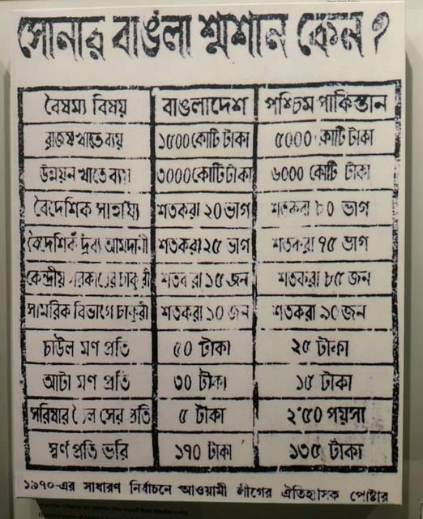
Election Poster of Awami League, 1970 Elections

Slide 11
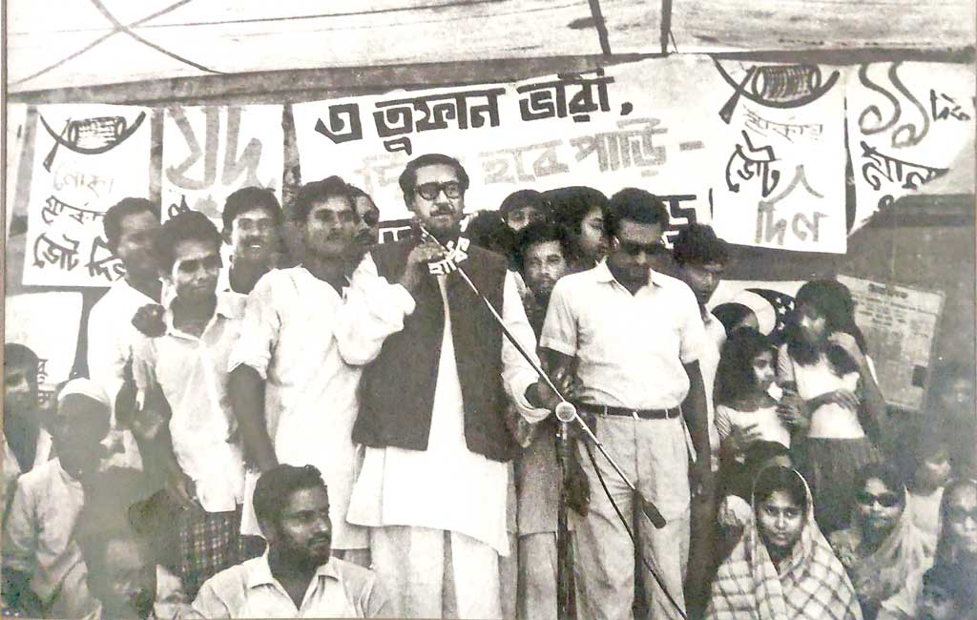
Bangabandhu addressing a meeting at Tejgaon during the election campaign 1970

Slide 12
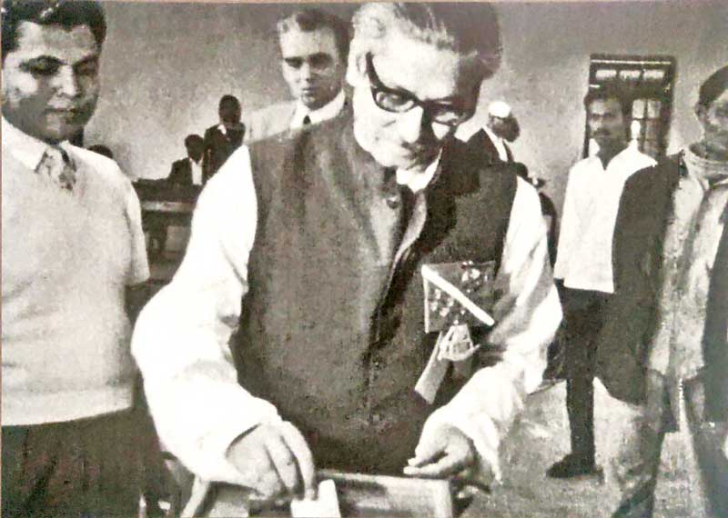
Bangabandhu Sheikh Mujibur Rahman casting his vote in the historic elections on December 7, 1970

Slide 13
The Elections of 1970
Facts about the Elections:
Campaign of the PPP focused on the Islamization of the Pakistani state, on democracy as the principle of the state, on socialism as the principle of the economy (Islamic Socialism!), and on continuous anti-India propaganda.
In fact, the 1970 elections turned into a direct competition between the two wings of Pakistan.
Dates of Election: Originally the date of election was fixed for 5 October 1970. But it was postponed to 7 December, 1970 because of devastating floods in East Pakistan.
Bhola Cyclone, Acid Test for the Government:
On November 3, 1970, there was a devastating cyclone in the coastal areas of East Pakistan (Bhola) killing thousands of people, cattle and destroying properties and houses which witnessed an utter negligence on the part of the government to help the affected people and provide relief.
President Yahya was very casual about it and his government even did not respond properly when foreign governments and agencies extended their helping hands.

Slide 14
The Elections of 1970
Bhola Cyclone:
The East Pakistan political parties and the public especially students did an exemplary work in helping the affected people. Awami League and its leaders won the hearts of the cyclone affected people by touring the areas and sending volunteers to provide relief to them.
In any case, the political leaders and the general public became extremely unhappy and discontented by the attitude of the government and specially Yahya Khan and other military generals.
On 13 November 1970, Maulana Bhasani called for an independent East Pakistan.
It was feared that the military government taking advantage of the natural disaster might postpone the election for an indefinite period. However, the government only postponed the election of the cyclone affected areas involving only nine (9) seats.
Elections in these seats were held on 17th January 1971.

Slide 15
The Elections of 1970
The Election(s) and its Results:
Finally the election was held on 7 December 1970 for the National Assembly of Pakistan in a very peaceful and organized manner. Awami League won a landslide victory in the election of the National Assembly securing 167 seats out of 169. This was a great surprise for the politicians of West Pakistan especially the military junta!
Awami League secured 82 percent of the votes cast in East Pakistan while in West Pakistan Bhutto’s People’s Party left others far behind. It alone secured 88 seats out of a total of 144 seats in WP.
Final Result: The Awami League in East Pakistan secured 167 (160+7) seats out of 169 in the National Assembly seats in East Pakistan, and 298 seats out of 310 in the Provincial Assembly .
In all Awami League secured 38.3 percent of the votes cast all over Pakistan while the PPP secured only 19.5 percent.
The Awami League secured majority in the National Assembly of Pakistan as a single party (167 out of 313 seats).

Slide 16
The Elections of 1970
Significance of the 1970 Elections:
1970 General Elections in Pakistan was the first ever national election in the history of Pakistan since its inception in 1947.
The Election was free, fair, credible, transparent and acceptable to all the stakeholders.
Analysis of the election results shows that Awami League proved to be the single majority party securing 167 seats in the National Assembly, but it could not secure any seat in West Pakistan, similarly the PPP proved to be majority party in West Pakistan with no seat in East Pakistan.
Therefore, the election results fueled confrontation between the two wings of Pakistan.
The London Times in its Editorial on December 9, 1970 branded the 1970 General Elections in Pakistan as “The first and perhaps last election.” In reality, this was the first and last general election in united Pakistan.

Slide 17
Post-1970 Elections development
Deadlock in the Pakistani politics
Agitations led by Dhaka University Student leaders
Bangabandhu’s 7th March Speech
Bhutto-Yahiya Settlement drama on 19th March
Operation Searchlight on 25th March
Declaration of Independence
Critical Overview

